Slide 1
Deep Learning Approaches for H&E to Multiplexed Immunohistochemistry Image Stain Translation
Chang Bian | 12/12/2024
Institution: Division of Informatics, Imaging & Data Sciences
Faculty of Biology, Medicine and Health University of Manchester
Supervisors: Martin Fergie; Tim Cootes; Beth Phillips
1

Slide 2
1
Introduction
2
Thesis Structure
Contents
4
Chapters Highlight
5
Conclusions and Future work
Notes:
Name,

Slide 3





Introduction
Traditional Medicine vs. Precision Medicine
GENETICS
Gene sequencing
Locate cancer-causing genes
TARGETED THERAPIES
Drugs turn specific genes on or off
IMMUNOTHERAPY
Identify ways to customise treatment
Find ways to turn immune system on
Personalised treatment with immune-activating drugs
RADIATION
High-energy particles damage or destroy cells
CHEMOTHERAPY
Chemicals attack cancer
SURGERY
Operate on part of the body to diagnose or treat cancer
Advanced
Personalised
Treatment
The response rate to immunotherapy remains relatively low, ranging from 20% to 40% [1].
Immunotherapy can cause significant side effects, potentially compromising patient health [2].
More information is needed to better guide treatment selection.
[1] Esfahani, Khashayar, et al. "Moving towards personalized treatments of immune-related adverse events." Nature reviews Clinical oncology 17.8 (2020): 504-515.
[2] Kichloo, Asim, et al. "Systemic adverse effects and toxicities associated with immunotherapy: a review." World journal of clinical oncology 12.3 (2021): 150.
Notes:
Name,

Slide 4
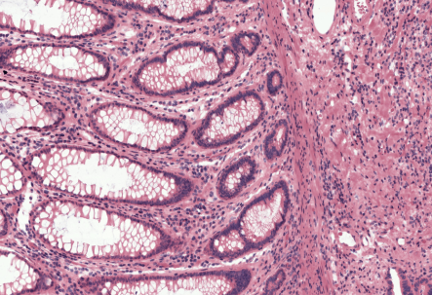
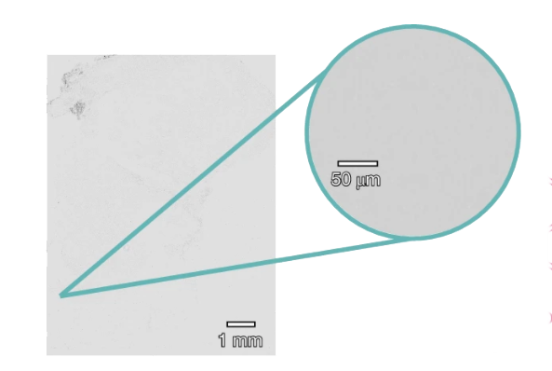
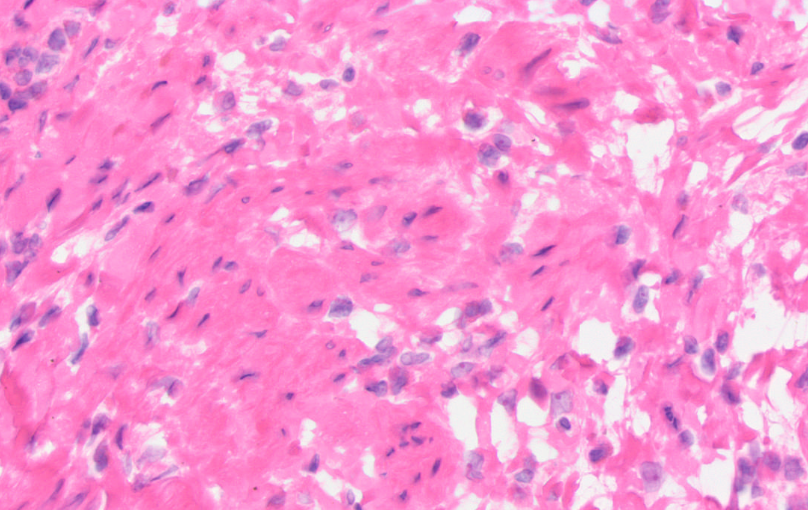
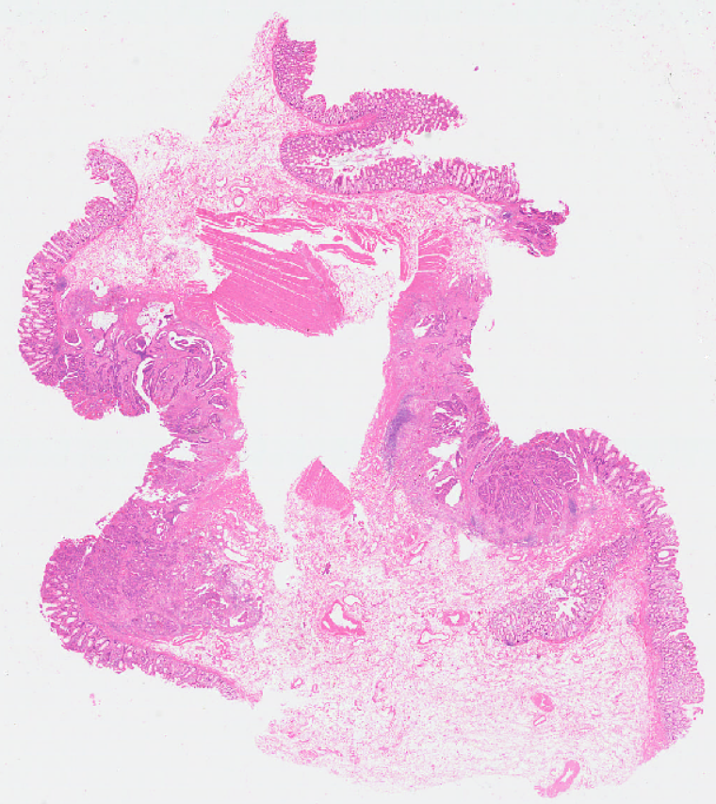
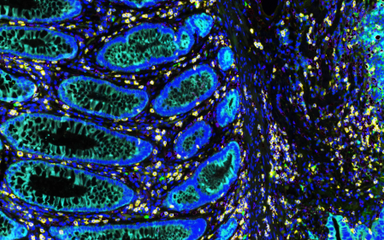
Introduction
Pathological diagnosis
Staining methods
histological staining
H&E
unstained tissue section
stained tissue section
Cell morphology
Stroma area
mIHC/mIF
Cell morphology
Stroma area
Protein marker expression and distribution
microscope imaging
Tissue biopsies, combined with various staining methods, provide valuable insights into the targeted area.
mIHC/mIF techniques enable detailed molecular characterisation, offering potential guidance for treatment selection.
Notes:
Name,

Slide 5
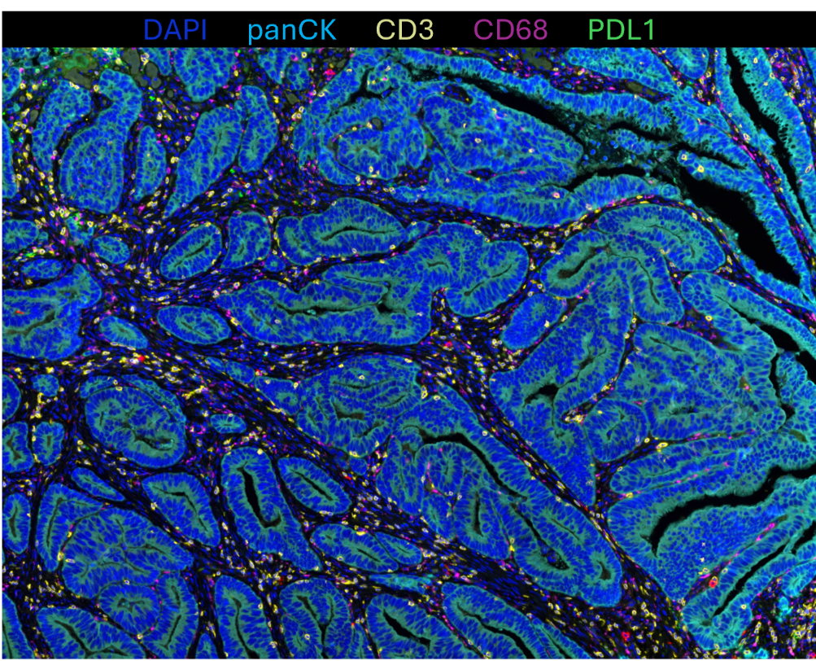
Introduction: Challenges
Data Acquisition
Data Interpretation
High cost of acquiring mIF/mIHC images.
Complex and time-consuming lab staining protocols.
Interpreting mIHC-stained images is a labour-intensive process that requires significant expertise.
The interpretation involves identifying positive cell groups and subtyping them, which requires precise thresholding of staining intensity.
Thesis Contents
Adaptive Thresholding Method for mIF/mIHC Marker Intensity Thresholding.
Deep Learning-Based Method for H&E to mIF/mIHC Image Stain Translation.
Validation
Notes:
Name,

Slide 6
Thesis structure
Introduction
Literature Review
An Adaptive Thresholding Method for mIHC/mIF Analysis
Application of the Adaptive Thresholding Method in Prediction of Prognosis in Melanoma
Transformer-Based Network for H&E to Multiplexed Immunohistochemistry Stain Translation
CNN-Transformers Dual-Branch Network for H&E to Multiplexed Immunohistochemistry Stain Translation
Exploration of the Generalization Ability of the Stain Translation Method on a Hodgkin Lymphoma Dataset
Conclusion
Notes:
Name,

Slide 7
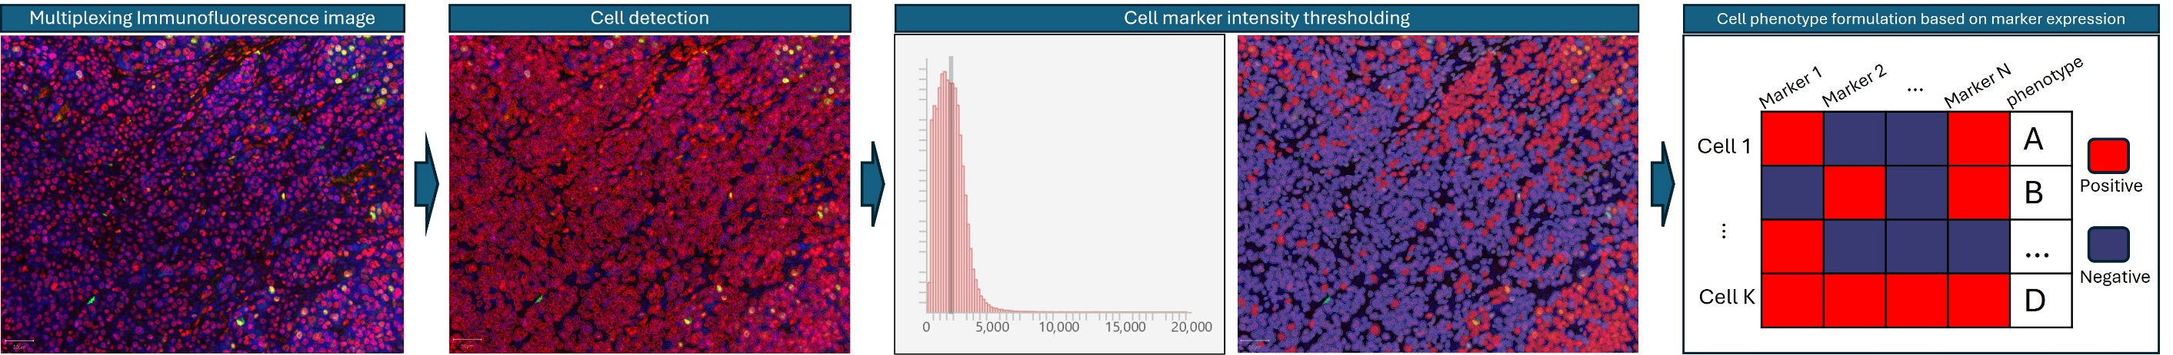
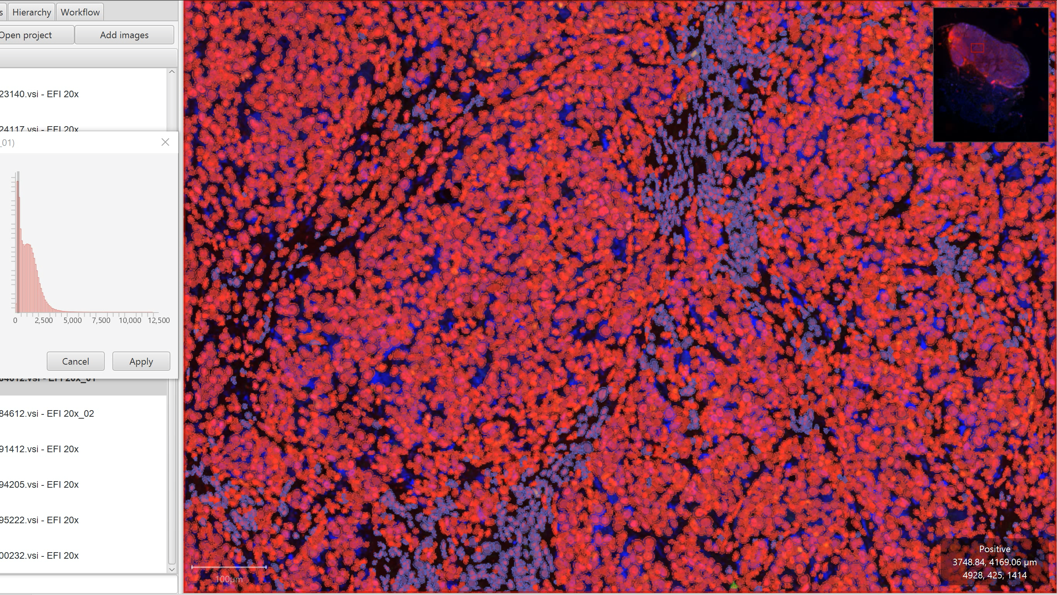
Chapter3: An Adaptive Thresholding Method for mIHC/mIF Analysis
Cell phenotyping pipeline
cell phenotyping involves identifying each cell from the image data and applying intensity thresholding to determine cell positivity.
Manual thresholding requires specialised expertise and it is a time-consuming process.
Aim:
Develop a reproducible and accurate systematic thresholding method.
Notes:
Name,

Slide 8
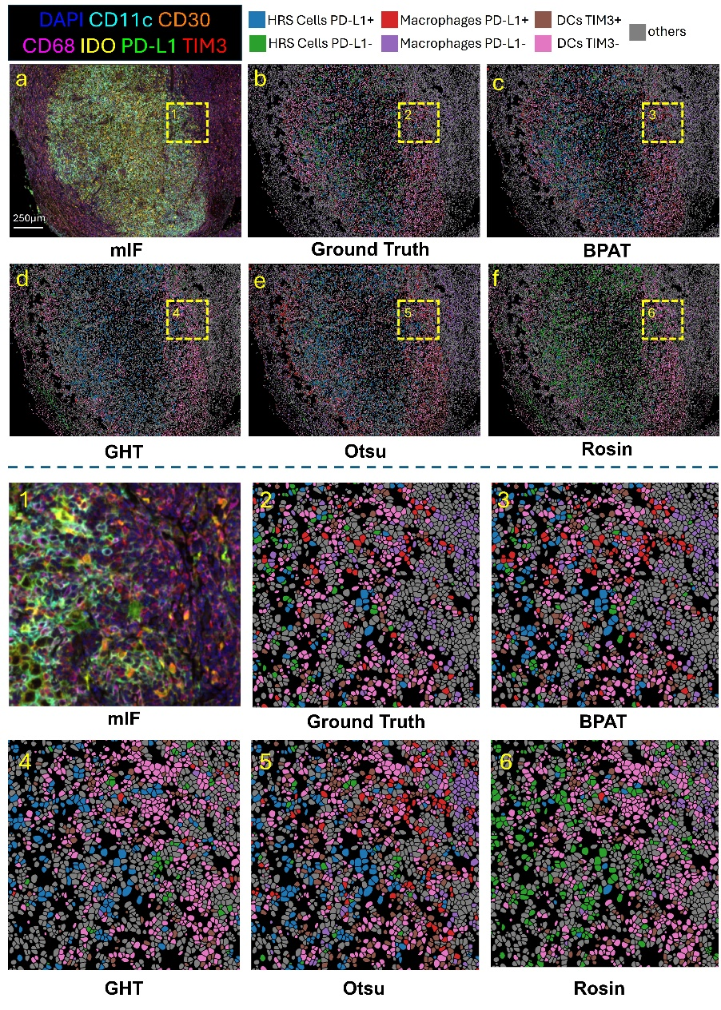
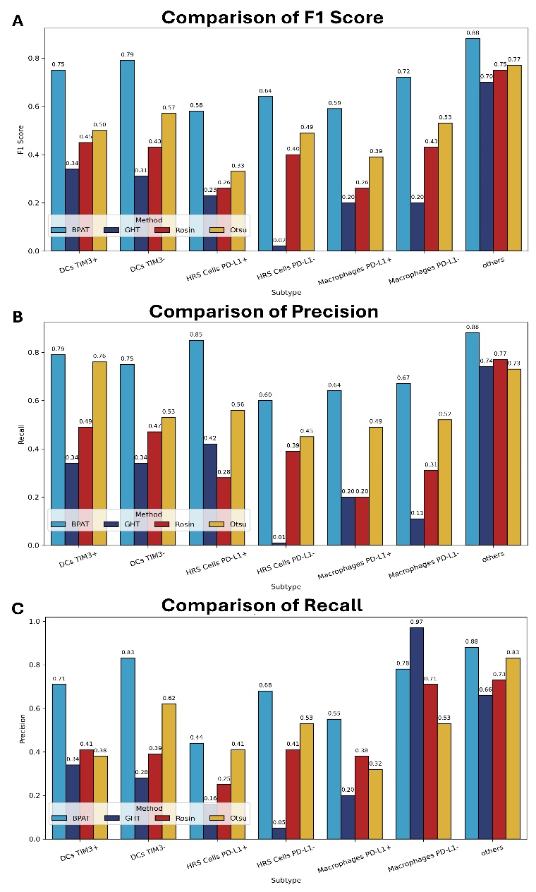
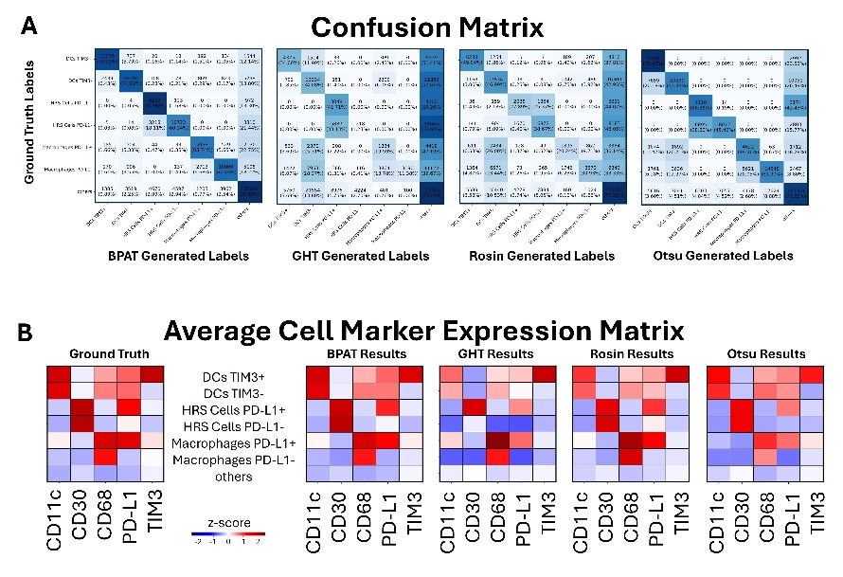
Chapter3: An Adaptive Thresholding Method for mIHC/mIF Analysis
Methodologies:
Problem Identification: Evaluate the performance of existing thresholding methods, such as Otsu, against manual thresholding results.
Method Development: Propose an adaptive thresholding method based on a Bayesian Gaussian Mixture Model; assess the impact of various data preprocessing techniques.
Method Evaluation: Compare the proposed method with 3 commonly used thresholding methods on 3 publicly available datasets. Visual and numerical results demonstrate its performance.
The proposed thresholding method outperforms other methods, achieving the highest scores across all three datasets.
Notes:
Name,

Slide 9
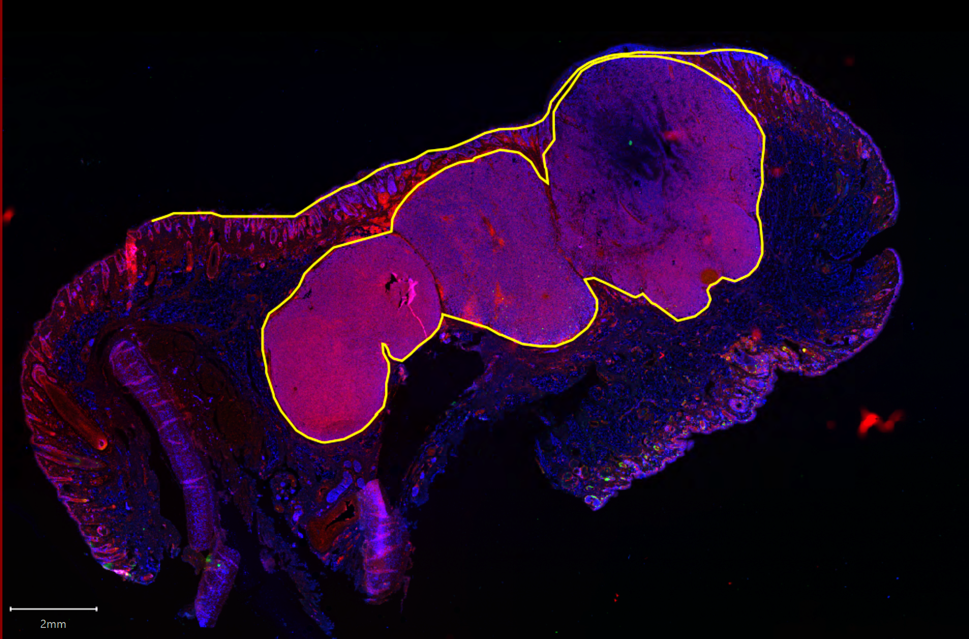
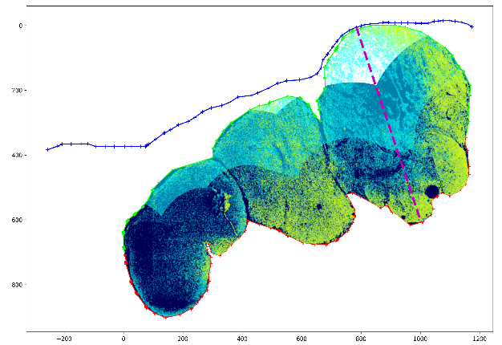

Chapter 4: Application of the Adaptive Thresholding Method in Prediction of Prognosis in Melanoma
Background
Cell morphology reflects certain molecular signatures
Naevoid melanomas subtype shows better prognosis with features simulating maturation, including changes in cell size and distribution.
General Idea
Spatial analysis
Superficial band
Middle band
Aim
Invasive band
Develop a computational pipeline to analyse melanoma across the depth of the tumour.
Establish whether there are potential prognostic biomarkers:
Proliferation
Nuclear Morphology
Targeted hypotheses to enable a small cohort study
Spatial information
Survival analysis
Clinical records
Notes:
Name,

Slide 10
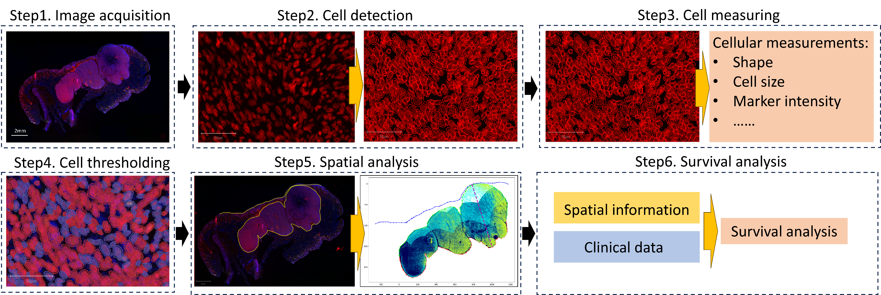
Chapter 4: Application of the Adaptive Thresholding Method in Prediction of Prognosis in Melanoma
Establish a computational pipeline incorporating the adaptive thresholding method we proposed in Chapter 3.
Findings:
1. Nuclei size in the invasive band emerging as a factor with a notably high hazard ratio
2. Multivariate Cox models demonstrated an improved mean concordance index upon incorporating nuclei size data.
3. The notable correlation between the invasive band's nuclei size of different cell categories and tumour thickness suggests a link between microlevel cellular changes and overall tumour progression
Notes:
Name,

Slide 11
Chapter 5: Transformer-Based Network for H&E to Multiplexed Immunohistochemistry Stain Translation
Hematoxylin and Eosin (H&E)
Most widely used
low cost
Simple preparation process
Can not identify specific protein markers
mIHC/mIF images:
provides further characterisation
higher cost
complex preparation process
Can identify specific protein markers
Question: How to acquire mIHC image data more efficiently?
Notes:
Name,

Slide 12
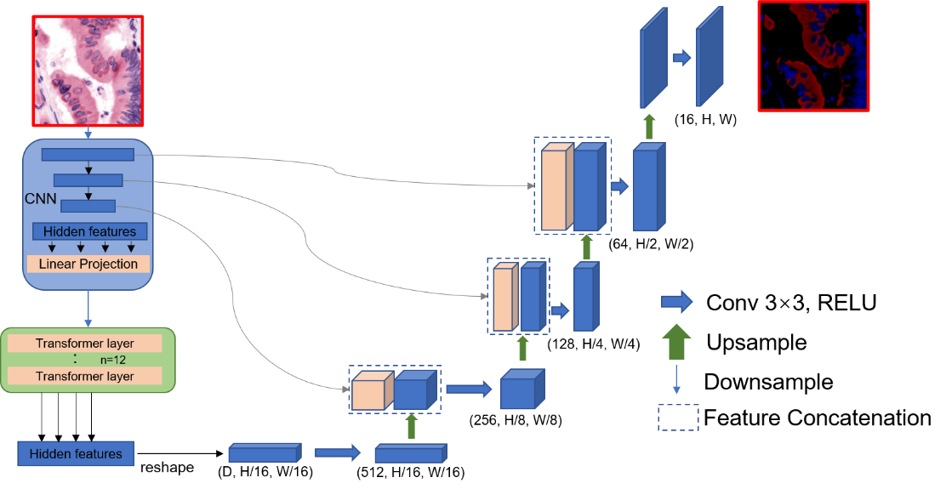
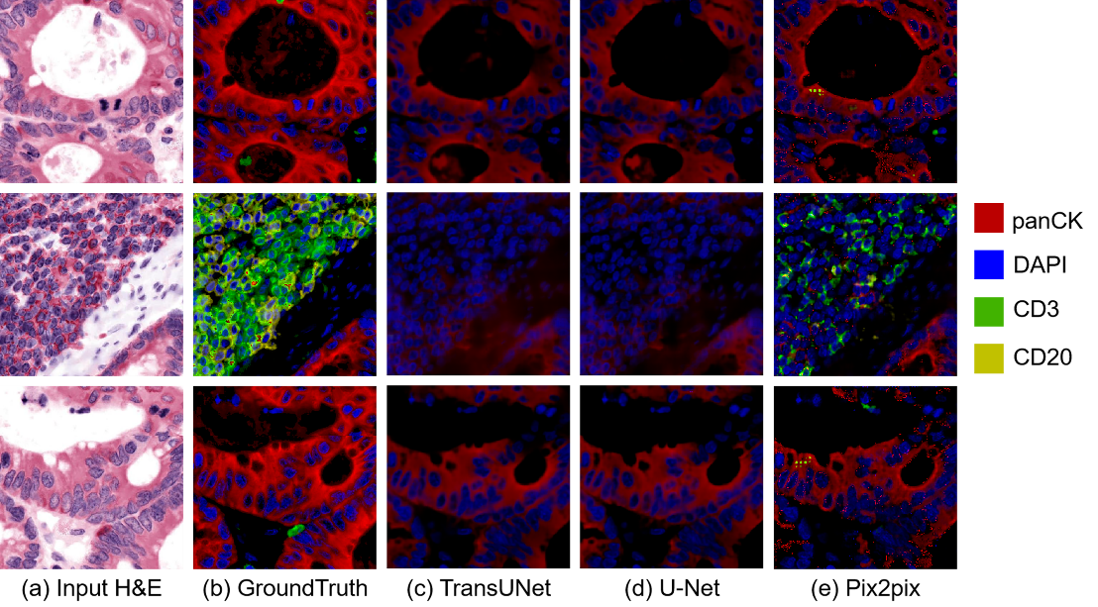
Chapter 5: Transformer-Based Network for H&E to Multiplexed Immunohistochemistry Stain Translation
Preliminary exploration for the following chapters:
We focus on:
The applicability of the transformer architecture in stain translation tasks.
The selection of appropriate network architectures.
The impact of different loss functions on performance.
Findings:
Transformer architecture shows good potential in stain translation tasks, achieving the highest SSIM scores in all the experiments.
Adding a cGAN loss in the pix2pix model could improve the prediction accuracy, especially for markers with a low expression rate.
SSIM alone as a metric for evaluating stain translation task may suffer from certain weaknesses.
TransUnet network
Next step:
Dataset establishment.
Pix2pix + transformer network architecture
Stain translation results using L1 loss
Notes:
Name,

Slide 13
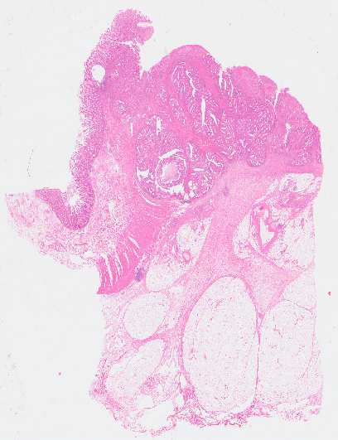
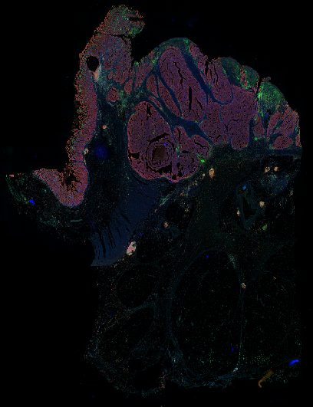
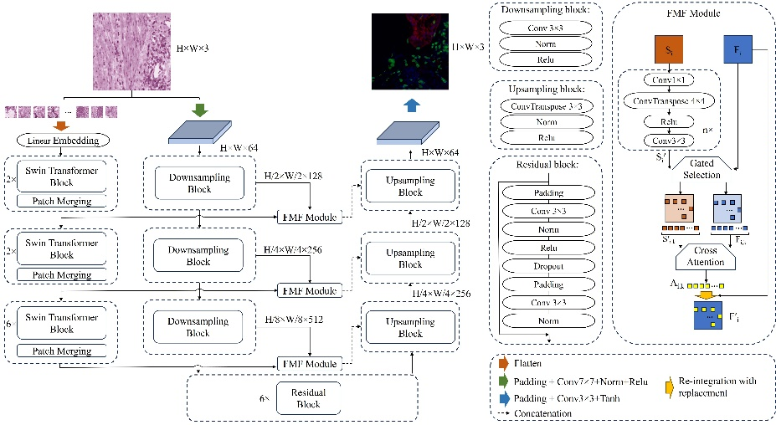
Chapter 6: CNN-Transformers Dual-Branch Network for H&E to Multiplexed Immunohistochemistry Stain Translation
Main contributions
Establishment of a dataset containing same-section cellular-level registered image pairs for model training.
Propose a dual-branch network structure tailored for H&E to mIHC image translation.
Notes:
Name,

Slide 14
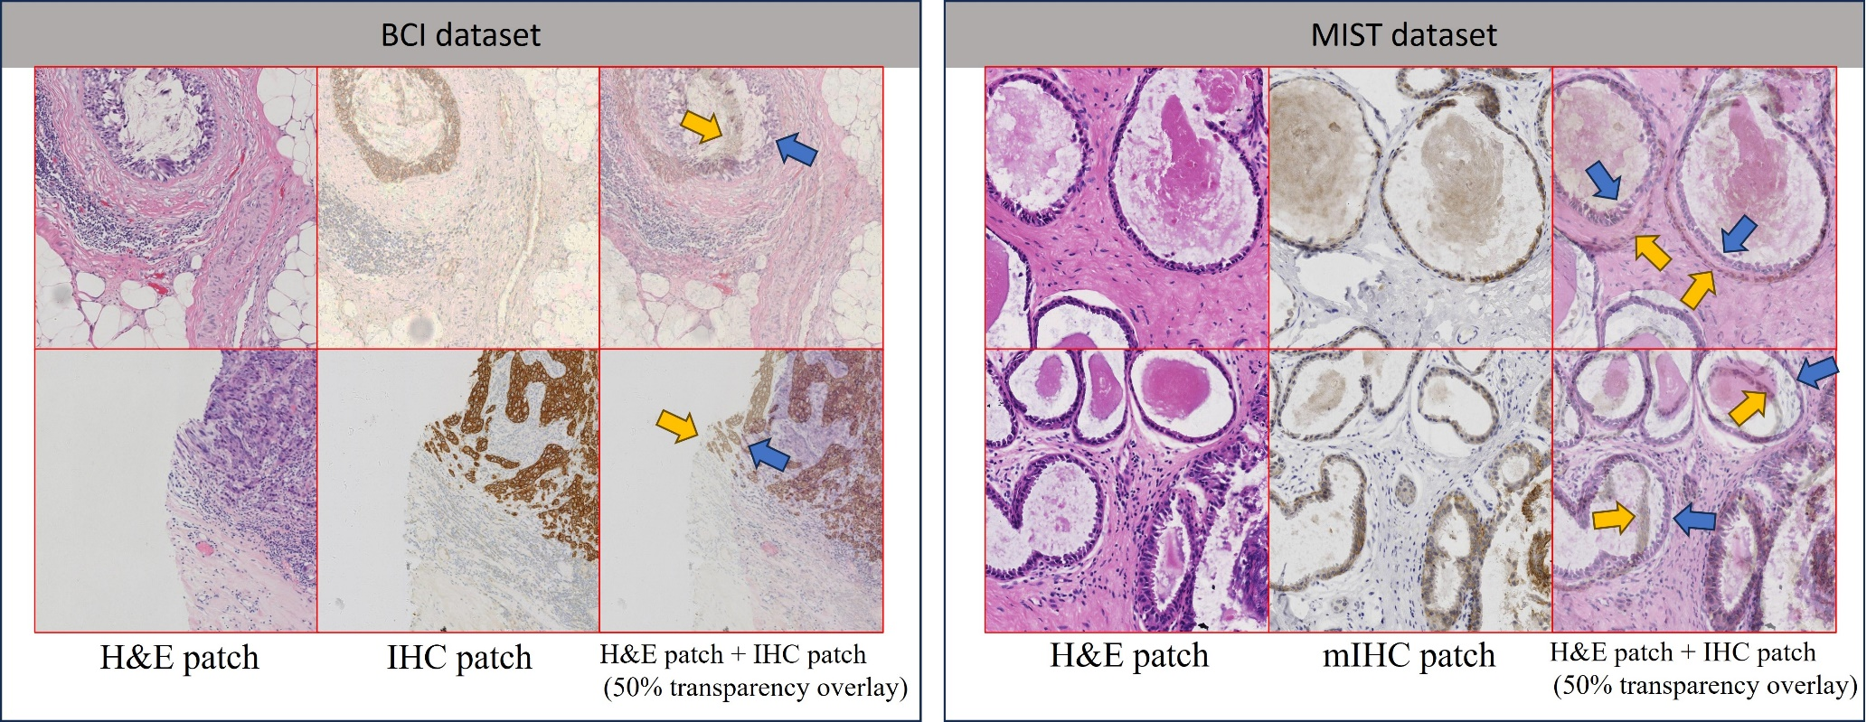
Chapter 6: CNN-Transformers Dual-Branch Network for H&E to Multiplexed Immunohistochemistry Stain Translation
A common problem of publicly available datasets: misalignment
Consecutive slides often suffer from misalignment and variations in tissue morphology due to differences in the depths at which sectioning happens. This may affect the network's ability to learn accurate feature mappings.
[1] Henning, Sophie, et al. "MIST: a Large-Scale Annotated Resource and Neural Models for Functions of Modal Verbs in English Scientific Text." arXiv preprint arXiv:2212.07156 (2022).
[2] Liu, Shengjie, et al. "Bci: Breast cancer immunohistochemical image generation through pyramid pix2pix." Proceedings of the IEEE/CVF conference on computer vision and pattern recognition. 2022.
Notes:
Name,

Slide 15
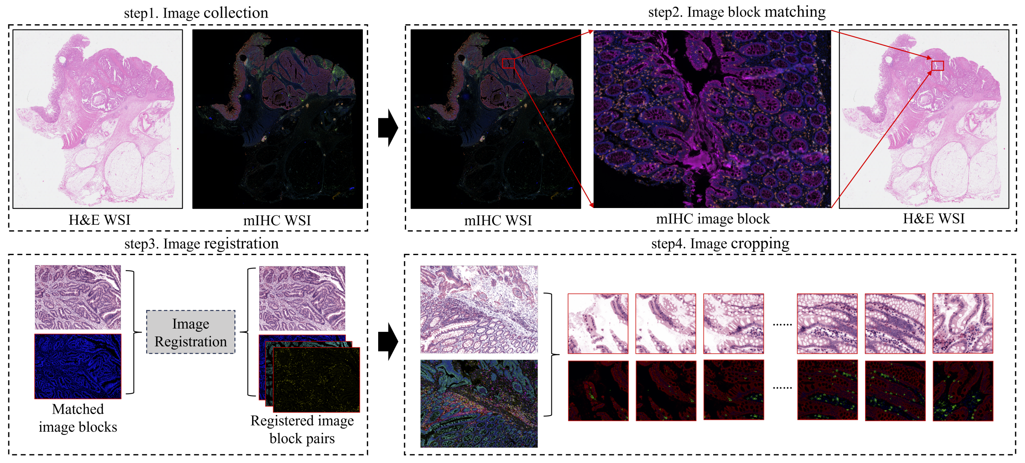
Chapter 6: CNN-Transformers Dual-Branch Network for H&E to Multiplexed Immunohistochemistry Stain Translation
HEMIT Dataset: processing pipeline
5292 image patches (1024 * 1024 )
To our knowledge, HEMIT is the first same-section cellular-level aligned dataset that enables H&E to multi-target mIHC image translation.
Notes:
Name,

Slide 16
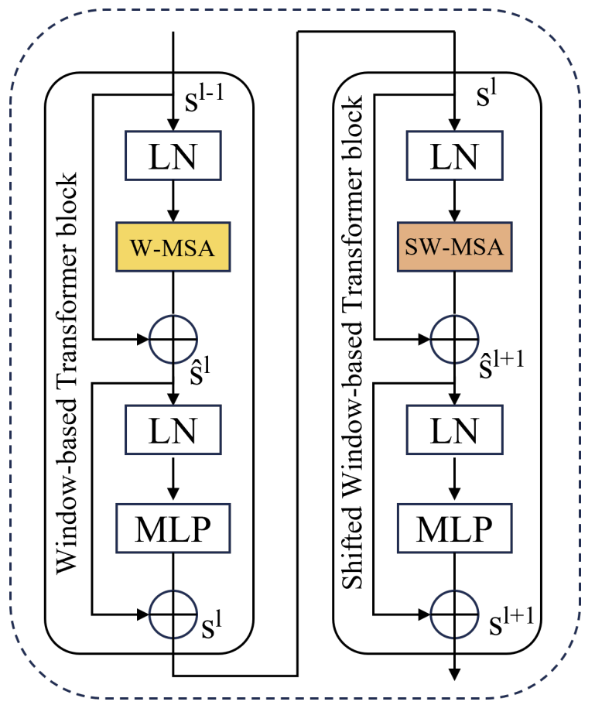
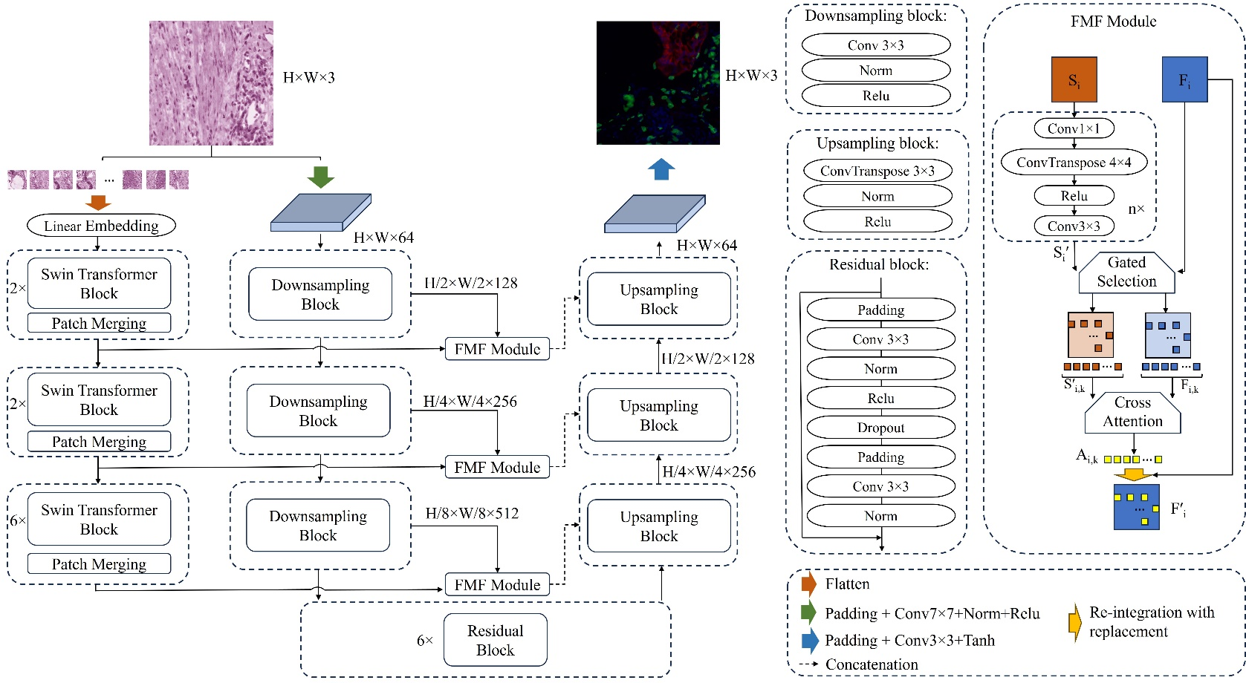
Chapter 6: CNN-Transformers Dual-Branch Network for H&E to Multiplexed Immunohistochemistry Stain Translation
Swin Transformer modules :
adeptly capture multi-scale features
We propose a new dual-branch generator architecture, using residual Convolutional Neural Networks (CNNs) and Swin Transformers which aims to achieve better translation outcomes
Notes:
Name,

Slide 17
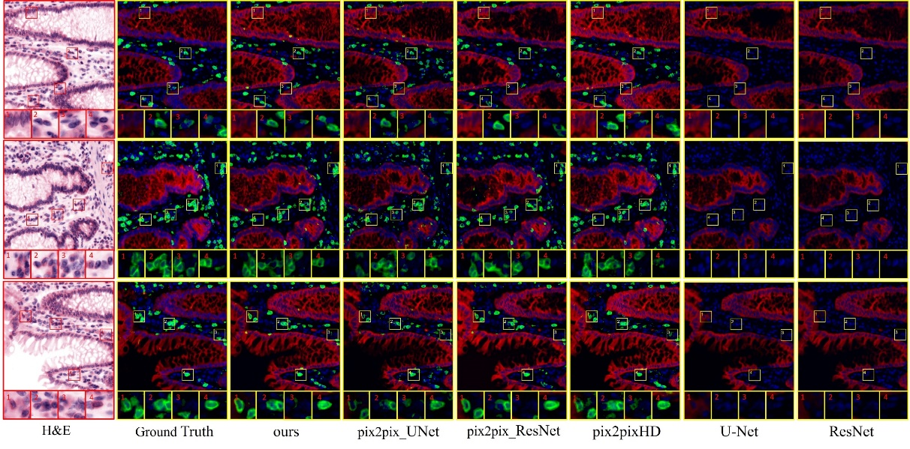
Chapter 6: CNN-Transformers Dual-Branch Network for H&E to Multiplexed Immunohistochemistry Stain Translation
Method validation
HEMIT Dataset:
Numerical evaluation:
SSIM
PCC
PSNR
Downstream analysis:
Positive cell proportions
Positive cell counts
InSilico Labeling dataset: (external dataset validation)
Numerical evaluation:
SSIM
PCC
PSNR
Our method achieves the best results among 3 key evaluation metrics compared to other SOTA methods
Our method achieves the best accuracy in positive cell identification downstream analysis.
Notes:
Name,

Slide 18
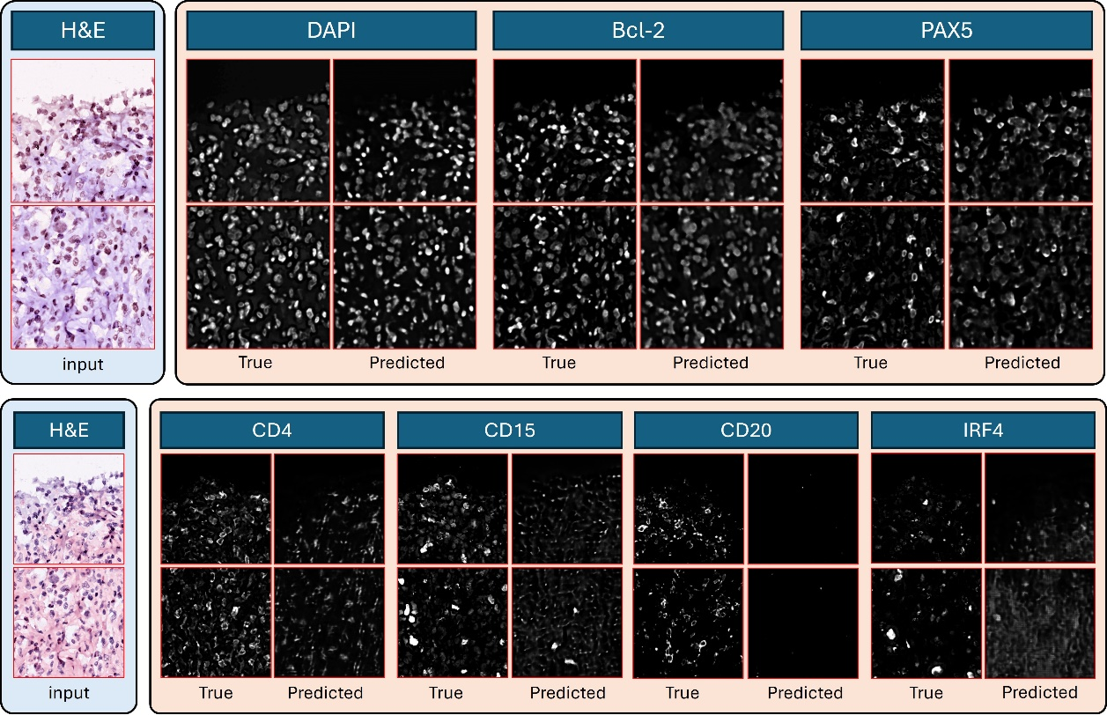
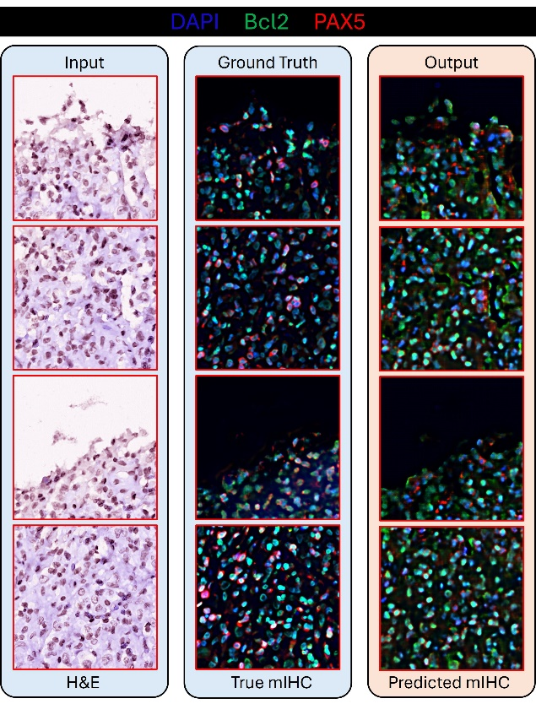
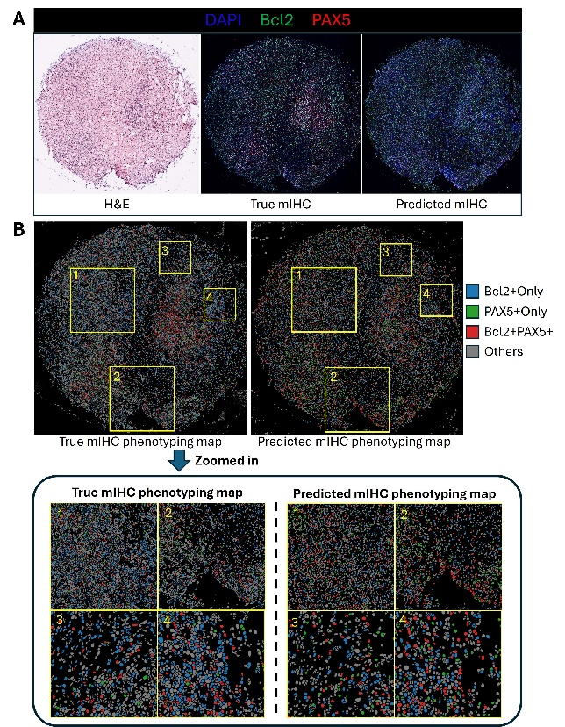
Chapter 7: Exploration of the Generalization Ability of the Stain Translation Method on a Hodgkin Lymphoma Dataset
Aim:
To validate if a wider spectrum of molecular markers can be directly predicted from H&E images.
to assess the feasibility of virtual staining to support more efficient tissue sample use, potentially conserving valuable biopsy material and enabling better-informed decisions in IHC panel selection when sample tissue is limited.
Single-channel experiment
Multi-channel experiment
Downstream analysis
Notes:
Name,

Slide 19
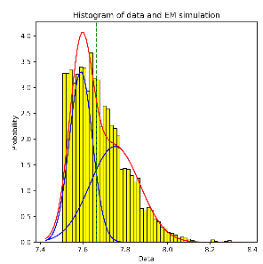
Conclusion and Future Work
Challenges
This Thesis
Data Acquisition
Adaptive Thresholding Method for mIF/mIHC Marker Intensity Thresholding.
(Chapter 3, 4)
High cost of acquiring mIF/mIHC images.
Complex and time-consuming lab staining protocols.
Future work
Integration of the uncertainty estimation mechanism into the general network.
Optimisation on the loss function to capture overall patterns.
Facilitate the use of large digitised H&E datasets, such as TCGA, to conduct quantitative analysis.
Facilitate mIHC/mIF marker analysis
Data Interpretation
Interpreting mIHC-stained images is a labour-intensive process that requires significant expertise.
The interpretation involves identifying positive cell groups and subtyping them, which requires precise thresholding of staining intensity.
Deep Learning-Based Method for H&E to mIF/mIHC Image Stain Translation.
(Chapter 5, 6, 7)
support more efficient tissue sample use
Facilitate preliminary panel selection
Notes:
Name,

Slide 20
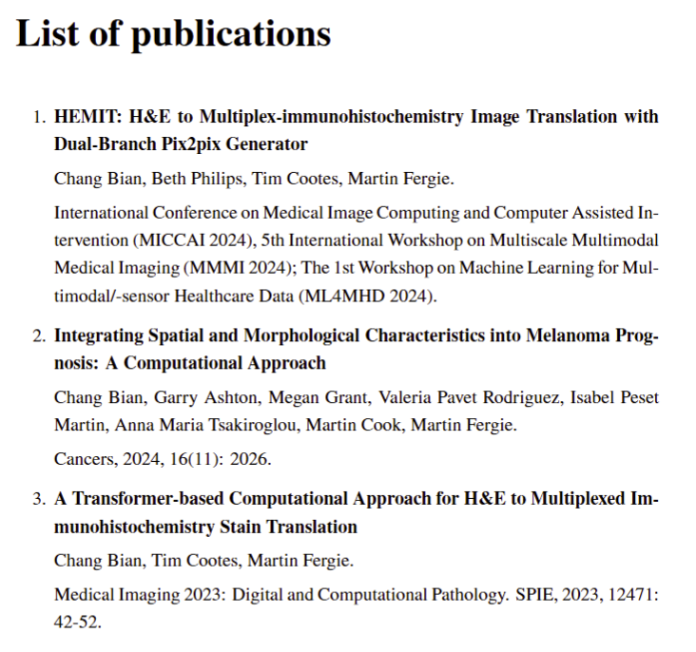
Thanks for listening
Chang Bian
Division of Informatics, Imaging & Data Sciences
School of Health Sciences
Faculty of Biology, Medicine and Health
University of Manchester
Email: chang.bian@postgrad.manchester.ac.uk

